Slide 1
Arrays
There is no check on the “index of-out-bound” type of errors, like in the load2xLifecyclesMethods:
“i” maximum value, “sz”, depends on the lcAnnotationClasses length, which is an attribute of the InterceptorManager, initialized by the constructor…
This “i” variable is used to access in the pre30LCMethodsNames and metaArray arrays…
Hard to tell if it will go out-of-bounds!
There are no guarantees!

Slide 2
Exceptions
In Load2xLifecycleMethods, noSuchMethodException is not handled
Also, beanClass.getMethod can raise a SecurityException that may be relevant to catch.

Slide 3
Exceptions
In AroundInvokeInterceptor , it might be better to catch more specific exceptions:
Only the general Exception is caught

Slide 4
Duplicates
There are many duplicates and very similar parts of code in our classes!

Slide 5
The methods load2xLifecycleMethods and loadOnlyEjbCreateMethod can be refactored using a common method:

Slide 6
Duplicates
Let’s see the class diagram of the InterceptorManager java source file:

Slide 7
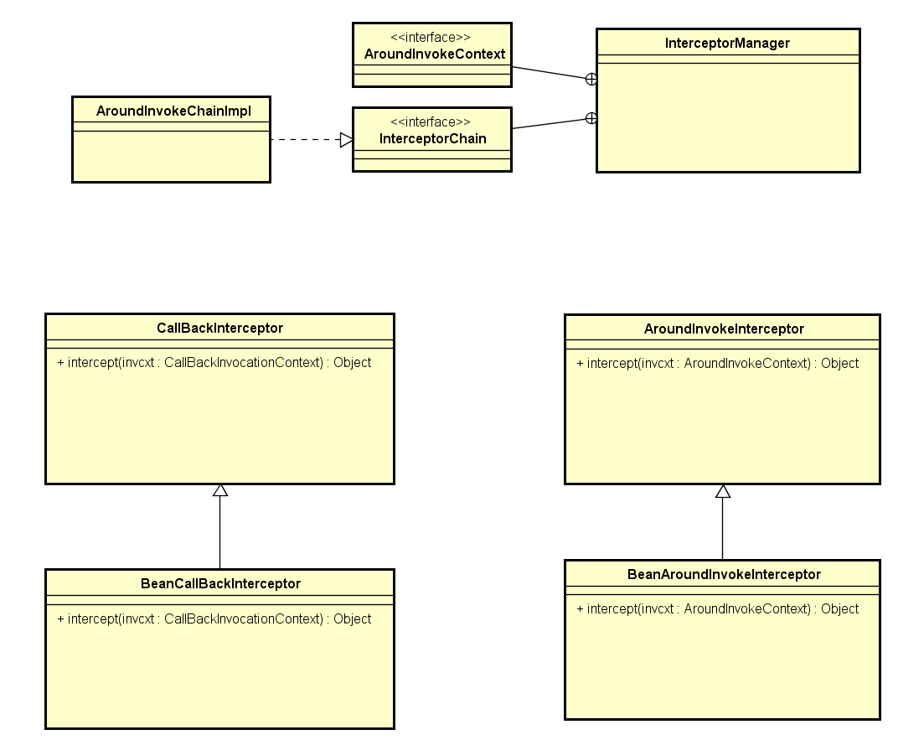
Main Public Class of the java file
Other (non Public) classes in this java file

Slide 8
Very similar classes!

Slide 9
AroundInvokeInterceptor
CallbackInterceptor
They have the the same constructor!

Slide 10
AroundInvokeInterceptor
CallbackInterceptor
Their only method, intercept, is very similar!
The only difference is argument of the method…
…on which, anyway, the same operations are done!

Slide 11
Even their subclasses are very similar!

Slide 12
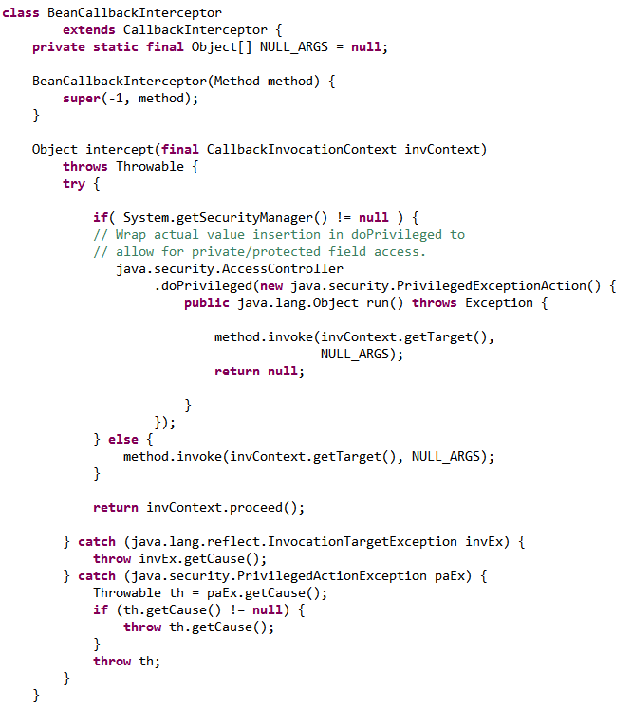
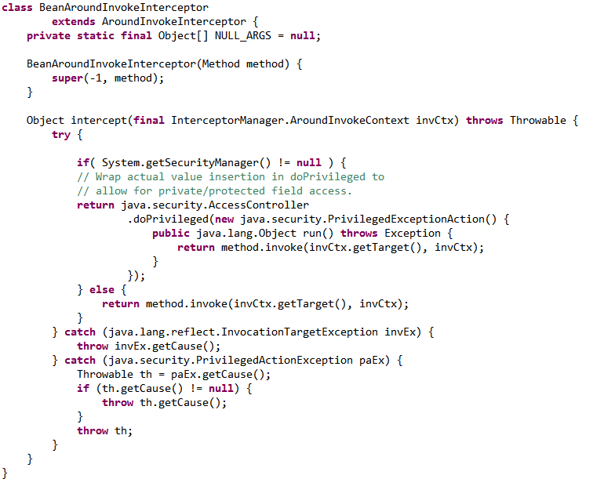
BeanAroundInvokeInterceptor
BeanCallbackInterceptor

Slide 13
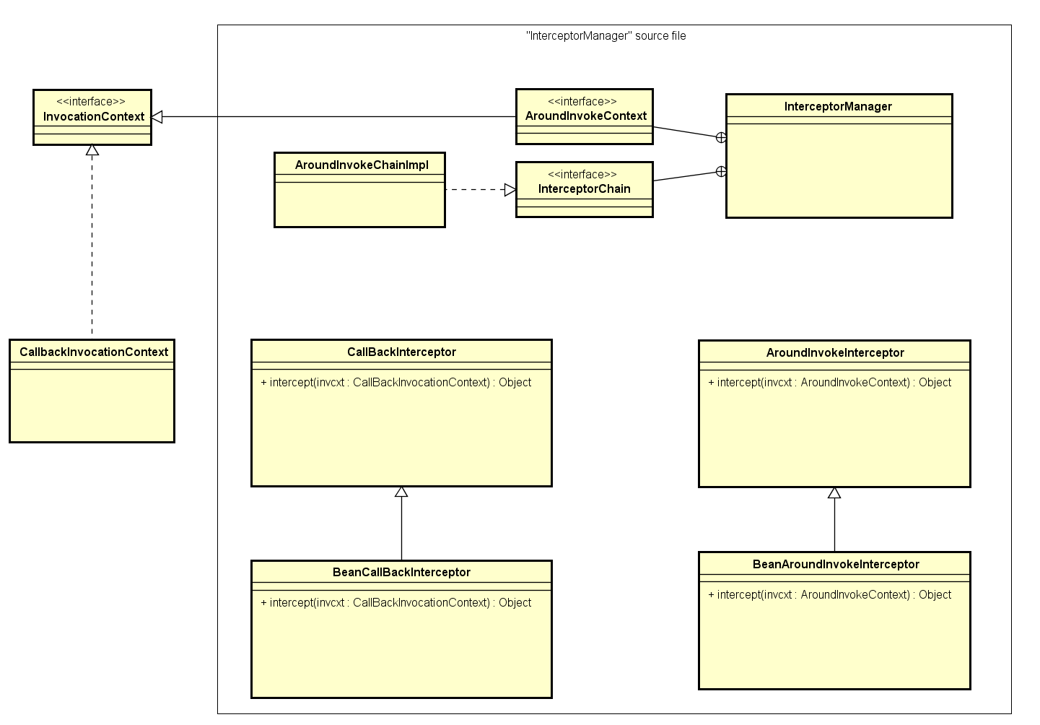
These method’s arguments are the real difference between the two classes

Slide 14
The class hierarchy should be reorganized so that CallbackInterceptor and AroundInvokeInterceptor inherits from a common class, which have the intercept(InvocationContext) method.

Slide 15
Thank you for your attention!
Questions?

